Slide 1
Data 211 Project:
Mood Tracker
Ava Gaines
Spring 2026 Semester

Slide 2
Research
Question
Company Name
Date
What affects my daily mood?
Does it depend on whether I go outside each day?

Slide 3
Data Overview
Observations
21 observations, collected daily with Daylio app, then transferred to excel
Variable 1
Did I leave the house that day?
Binary: yes or no
Variable 2
What was my mood that day?
Continuous: 1-5

Slide 4
What is being measured?
01
Claim
Going outside has a statistically significant effect on my mood quality
02
Dependent
Variable
What was my daily mood? Scale of 1 (worst) to 5 (best)
03
Independent
Variable
Did I go outside?
Yes or No

Slide 5
Hypothesis Testing
Step 1
Step 2
Step 3
Step 4
Null
Hypothesis
H₀ : μ_{yes} = μ_{no}
No difference in mood between days when I leave my home and days when I do not
Alternative
Hypothesis
H_{a} : μ_{yes} > μ_{no}
Mood is higher on days when I leave my home than on days when I do not
Use t-test
(more data on next slide)
Test statistic:
T = 0.7687
P-value = 0.2258
Reach a conclusion:
Based on collected data, fail to reject the
Null hypothesis

Slide 6
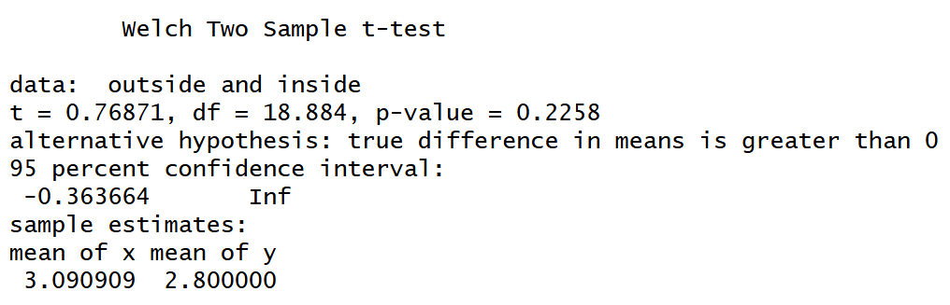
T-test and summary statistics

Slide 7
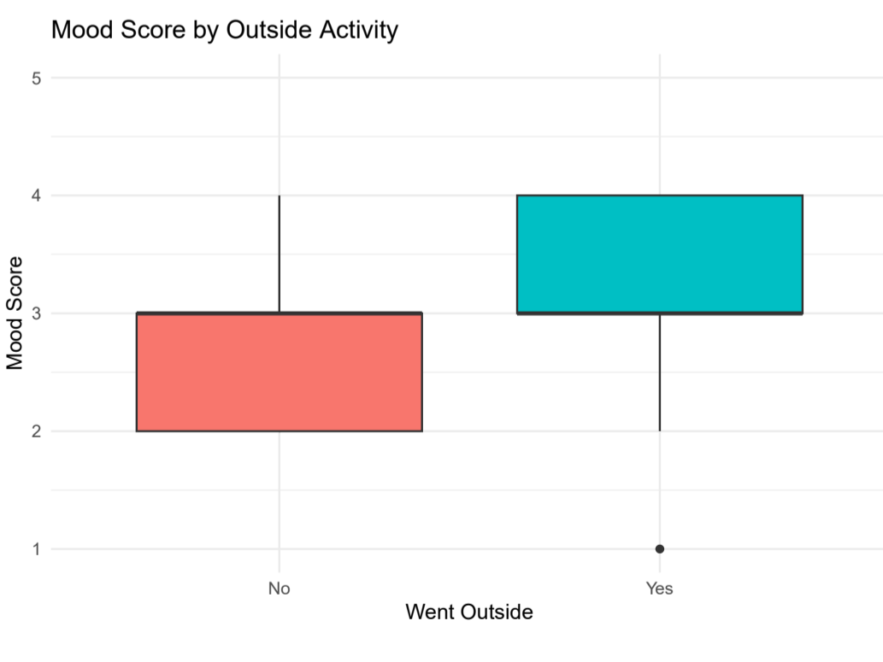
Conclusion:
Fail to reject the Null Hypothesis
Because the p-value is 0.2258 which is more than 0.05, we fail to reject the null hypothesis.
Although the average mood of outside days is higher than the average mood of inside ones, the difference is not statistically significant. The same goes for the higher variance present on outside days.
We do not have sufficient evidence that going outside influences mood quality, and the small difference between the means could easily be attributed to random chance.

